Slide 1
WELCOME

Slide 2

Hospital Management System
This presentation will probably involve audience discussion, which will create action items. Use PowerPoint to keep track of these action items during your presentation
In Slide Show, click on the right mouse button
Select “Meeting Minder”
Select the “Action Items” tab
Type in action items as they come up
Click OK to dismiss this box
This will automatically create an Action Item slide at the end of your presentation with your points entered.
H.R INSTITUTE OF TECHNOLOGY
PRESENTS
A
complete solution
For
Hospital Services and Activity

Slide 3
About
We are pleased to introduce you the
Hospital Management System is intended to provide complete solutions for spatients as well as Doctors through a single get way using the internet as the sole medium. Doctor and patient can check on patient’s data any time remotely

Slide 4
Hospital Management Systems
This software targets to provide complete solution for Hospital and related services.
The software Includes following:
Admin Management
Doctor Login
Patient Login
OPD
Create/Edit User
Backup
Add/ Edit Doctor
continued

Slide 5
Hospital Management Systems
Patient registration.
Consultancy Record
OPD Bill
Add/Edit Finding
Add/Edit Advise
Conflicting Medicine composition

Slide 6
Hospital Management Systems
Registration
Doctor
Patient
Login
Doctor
Patient
OPD
Patient List
Search list
Accounts Report

Slide 7
Requirement
Operating System
Windows NT 4.0 and above
Windows
Database
My SQL
SQL SERVER
APACHE TOMCAT 9.0

Slide 8
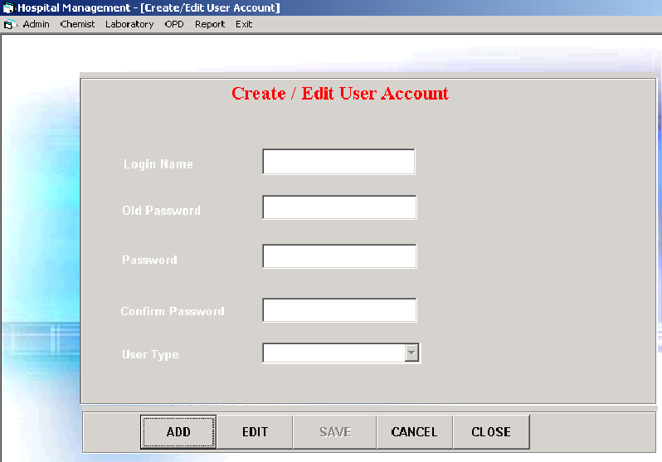
Hospital Management Systems
DATA FLOW DIAGRAMS

Slide 9
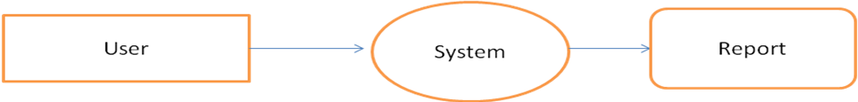
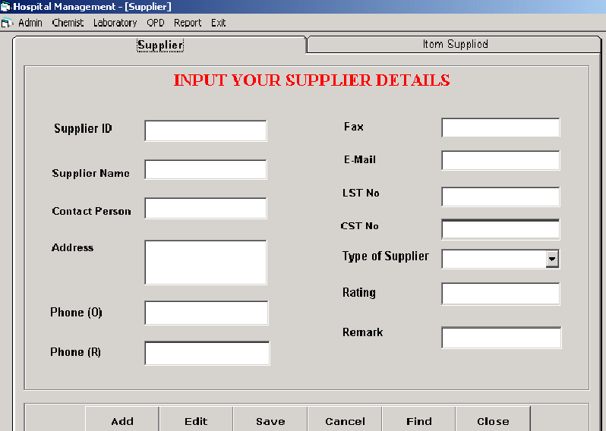
Hospital Management Systems

Slide 10
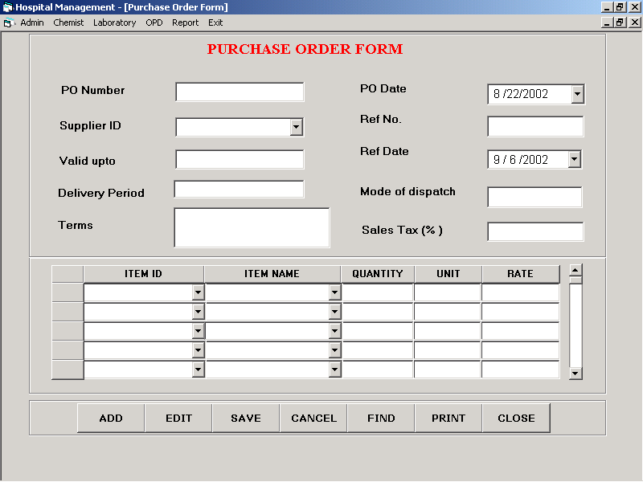
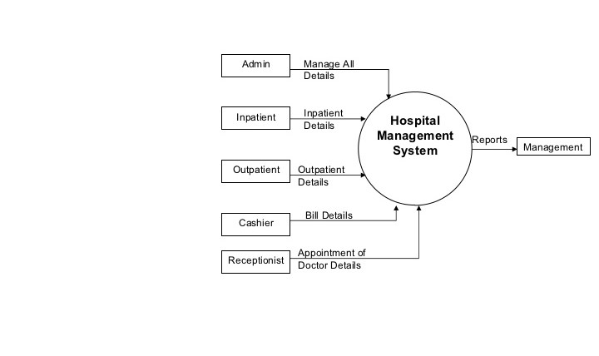
Hospital Management Systems

Slide 11
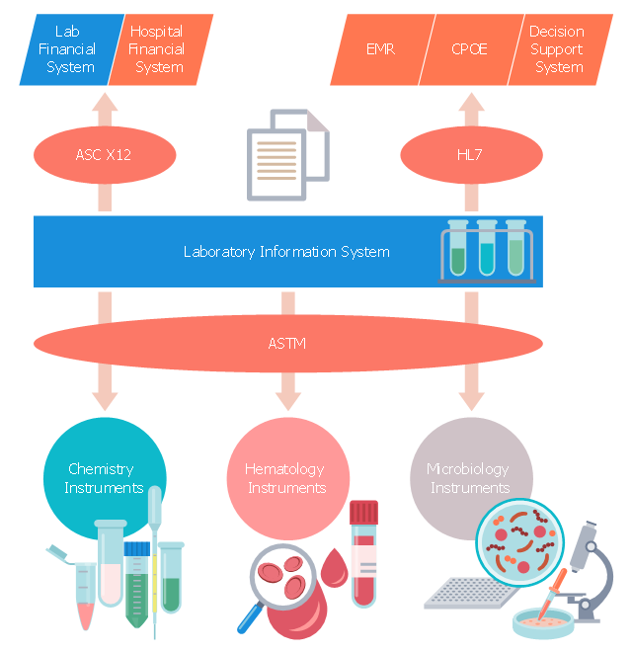
Hospital Management Systems

Slide 12
Software At A Glance
FUNCTIONALITY

Slide 13
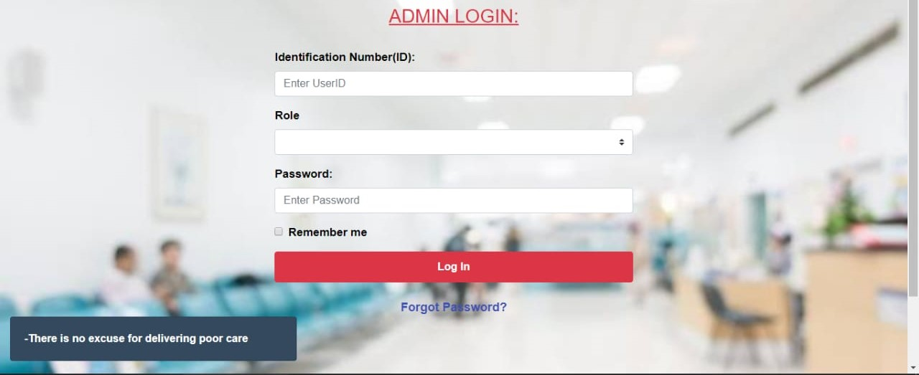
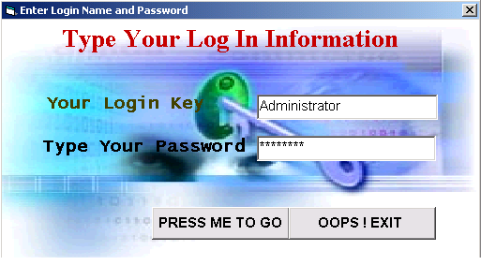
Hospital Management Systems

Slide 14
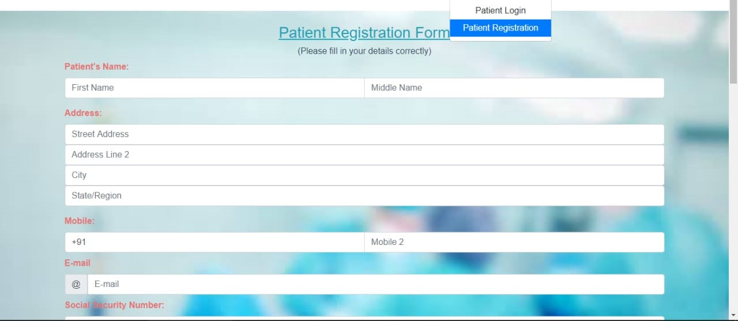
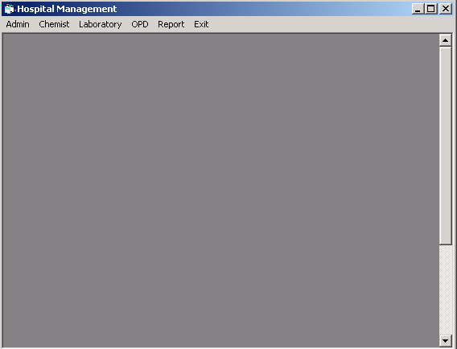
Hospital Management Systems

Slide 15
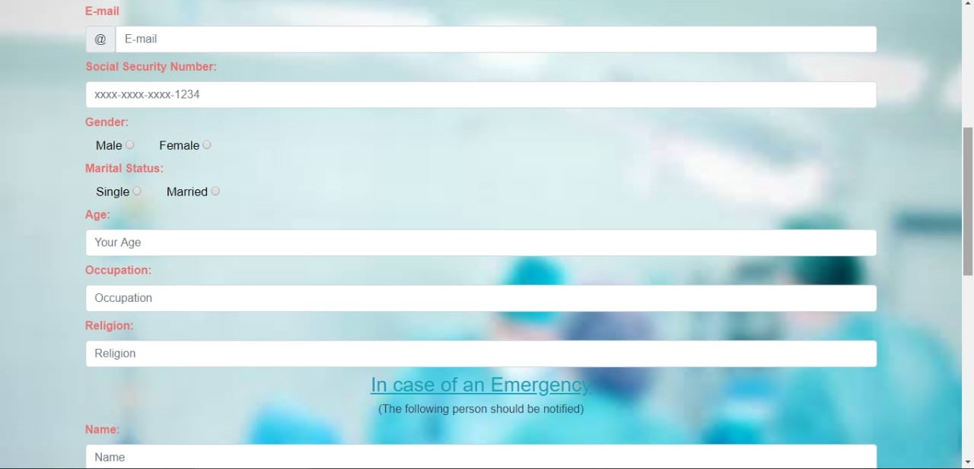
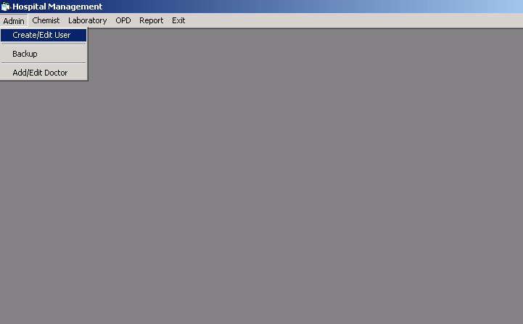
Hospital Management Systems

Slide 16
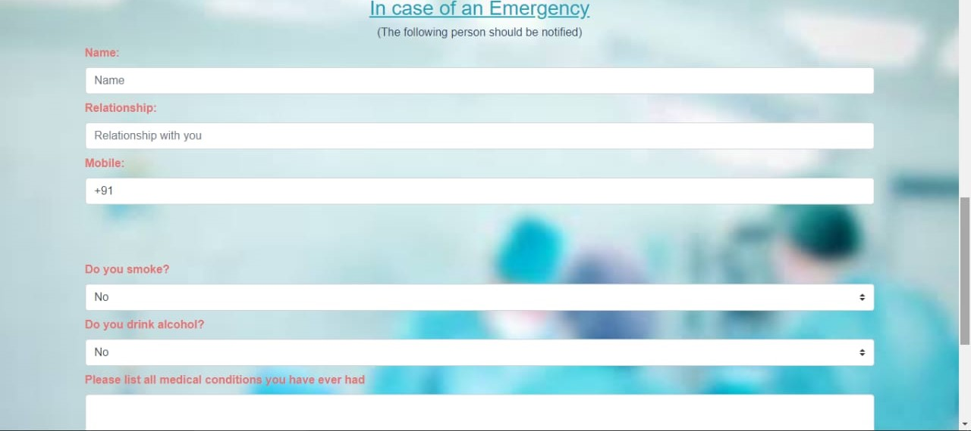
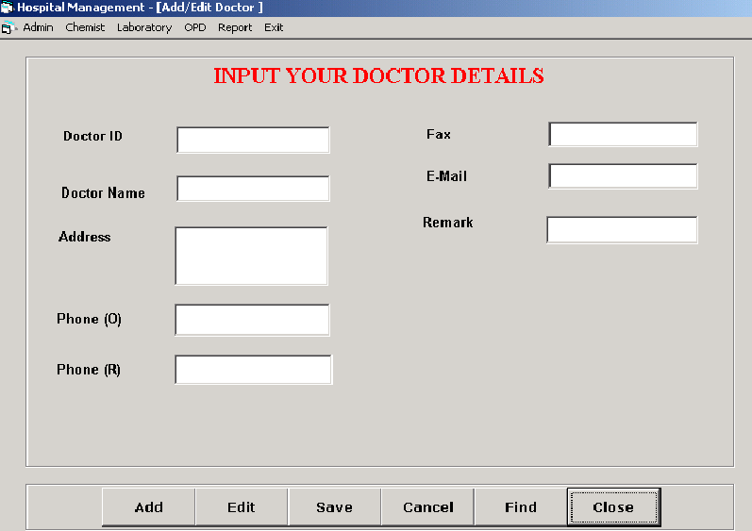
Hospital Management Systems

Slide 17
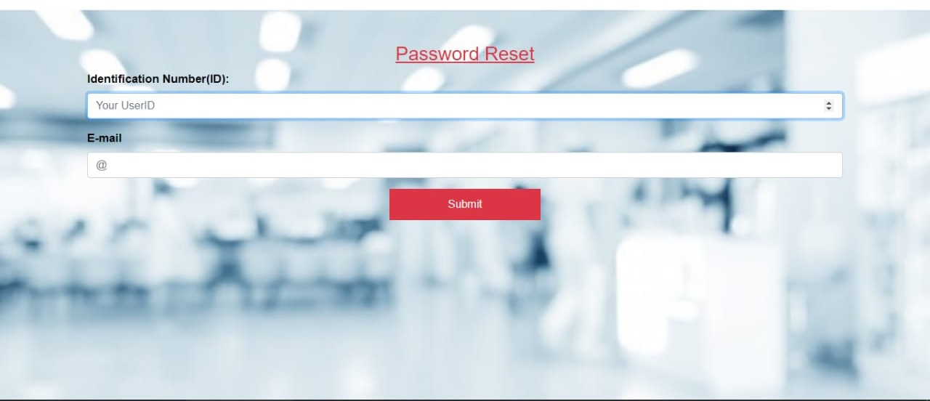
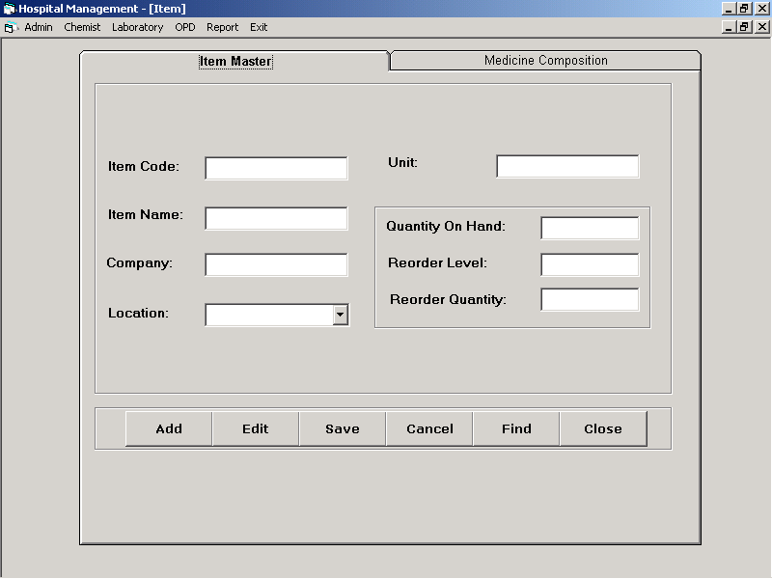
Hospital Management Systems

Slide 18
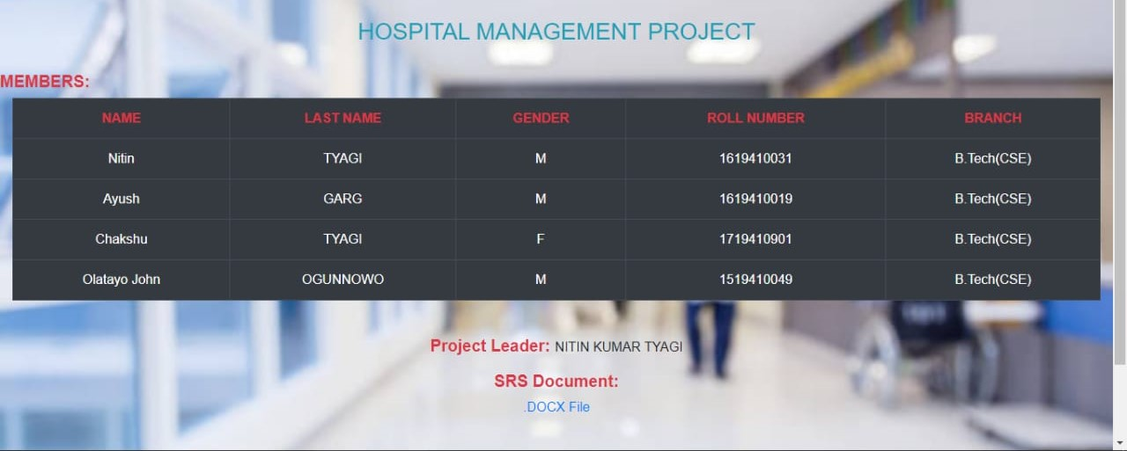
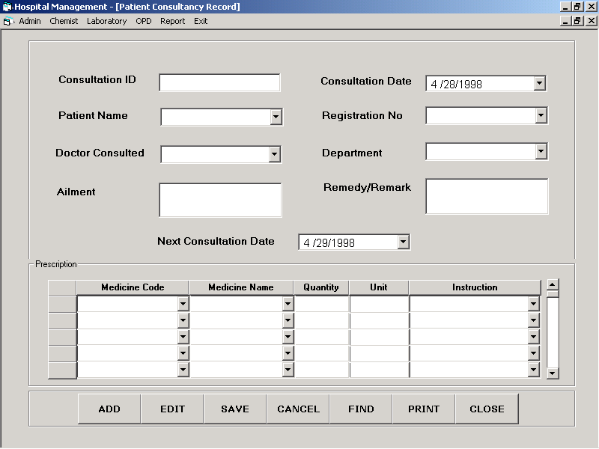
Hospital Management Systems

Slide 19
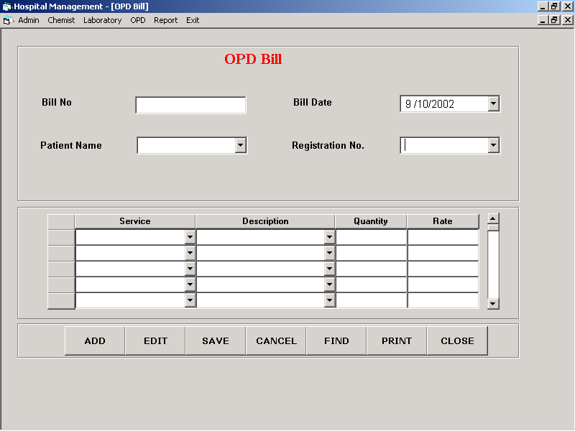
Hospital Management Systems
THANK YOU

